Slide 1
Software Engineering Project Happy with Lappy
COEN 285 –Fall 2014
TEAM 5
Aditee Nagle
Lizilina Parhi
Rachna Gajre
Seema Sardesai

Slide 2
Agenda
Introduction
Requirements Gathering
Design
User Interface
Conclusion

Slide 3
Autism
A hair dryer kid in toaster brained world
— Courtesy Dr. Meek, www.docmeek.com

Slide 4

What is Autism?
Developmental disorder that appears in the first 3 years of life, and affects the brain's normal development of social and communication skills
A “spectrum disorder” that affects individuals differently and to varying degrees
There is no one cause of autism just as there is no one type of autism

Slide 5
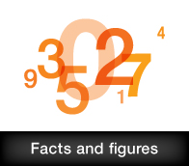
Facts and Figures
Fastest-growing serious developmental disability in U.S
Five times more likely in boys than girls
Affects 1 in 68 children and 1 in 42 boys
Costs a family $60,000 a year on average

Slide 6
Symptoms
Repeating behavior and patterns
Lack of social interaction skills
Lack of communication skills
Lack of cognitive skills

Slide 7
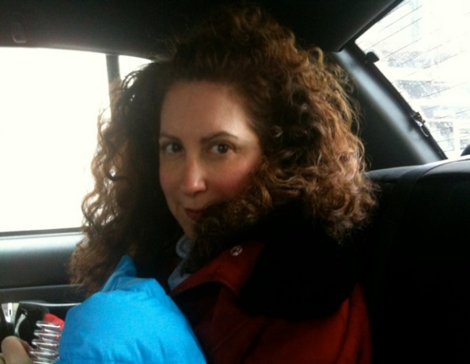
SIRI and friends
Her son has autism and his best friend is SIRI
Feels inanimate objects have souls
Takes his iPhone to the apple store to meet his friends
Judith Newman
Prominent American journalist and author

Slide 8
Reasons for irregular behavior
Attention seeking
Escape something they don’t want or can’t understand
Want something they don’t have
Sensory regulation

Slide 9
Objective
To conduct a study on autism and design a product idea to make autistic children happy

Slide 10
Requirements
Section 1

Slide 11
Requirement Gathering
Stakeholders Involved
Autistic children
Caretakers including parents, teachers, friends, supporters and many others who are have related interest in the patient

Slide 12
Requirement Elicitation Techniques
Case Studies
4 personal interviews with teachers at autistic school
Ethnography
Autism center school tour
Online survey
15 survey responses

Slide 13
Personal Interview
Class strength 8, one teacher per student
15 minute activity slots, then teachers rotate
Same teacher as escort every day, no changes
Separate programs for adults and children
Objective to keep them happy and make them learn in their own way

Slide 14
Student Study
Cognitive delays: Cannot process at normal pace
Can’t listen and understand at the same time
Most students have reduced motor skills
Aggression in the face of stress
Cannot handle change easily

Slide 15
Anecdotes
Girl avoided doing Mathematics, loved fairy tales. Solved Mathematics easily when mixed in the story
Boy drank something sour from a glass thinking it was milk. Doesn’t touch milk in a glass anymore
A middle aged man was told not to ask everyone ‘how old are you’. But he was so curious to know, that he started asking everyone ‘how young are you’

Slide 16
Survey Analysis

Slide 17
Observations
Males mostly affected
Age group 1-17 most affected followed by 18-25
Diagnosis and support at early age helps to monitor and guide their progress
Small attention span, need multiple points of attention
Don’t like changes
Very possessive of belongings

Slide 18
Scope of our project
What problems are we trying to solve? | Possible solutions
Lack of speech | Expressing through visual representations
Cognitive delay | Learning through pictures / videos
Anxiety due to uncertainty | Follow pre-determined schedule
Unstable behavior/emotions | One-on-one training at early age
Lack of or limited motor skills | Developing skills through customized tasks
Each child is unique, no common solution | Building on existing interests/skills

Slide 19
Expectations from Product-to-be
Assistive technology for children (age 17 or below)
Facilitate expression through visual representations
Provide platform for customized learning programs
Provide customized interfaces for limited motor skills
Act as a scheduling tool to use and create customized schedules
Act as a companion for fun games

Slide 20
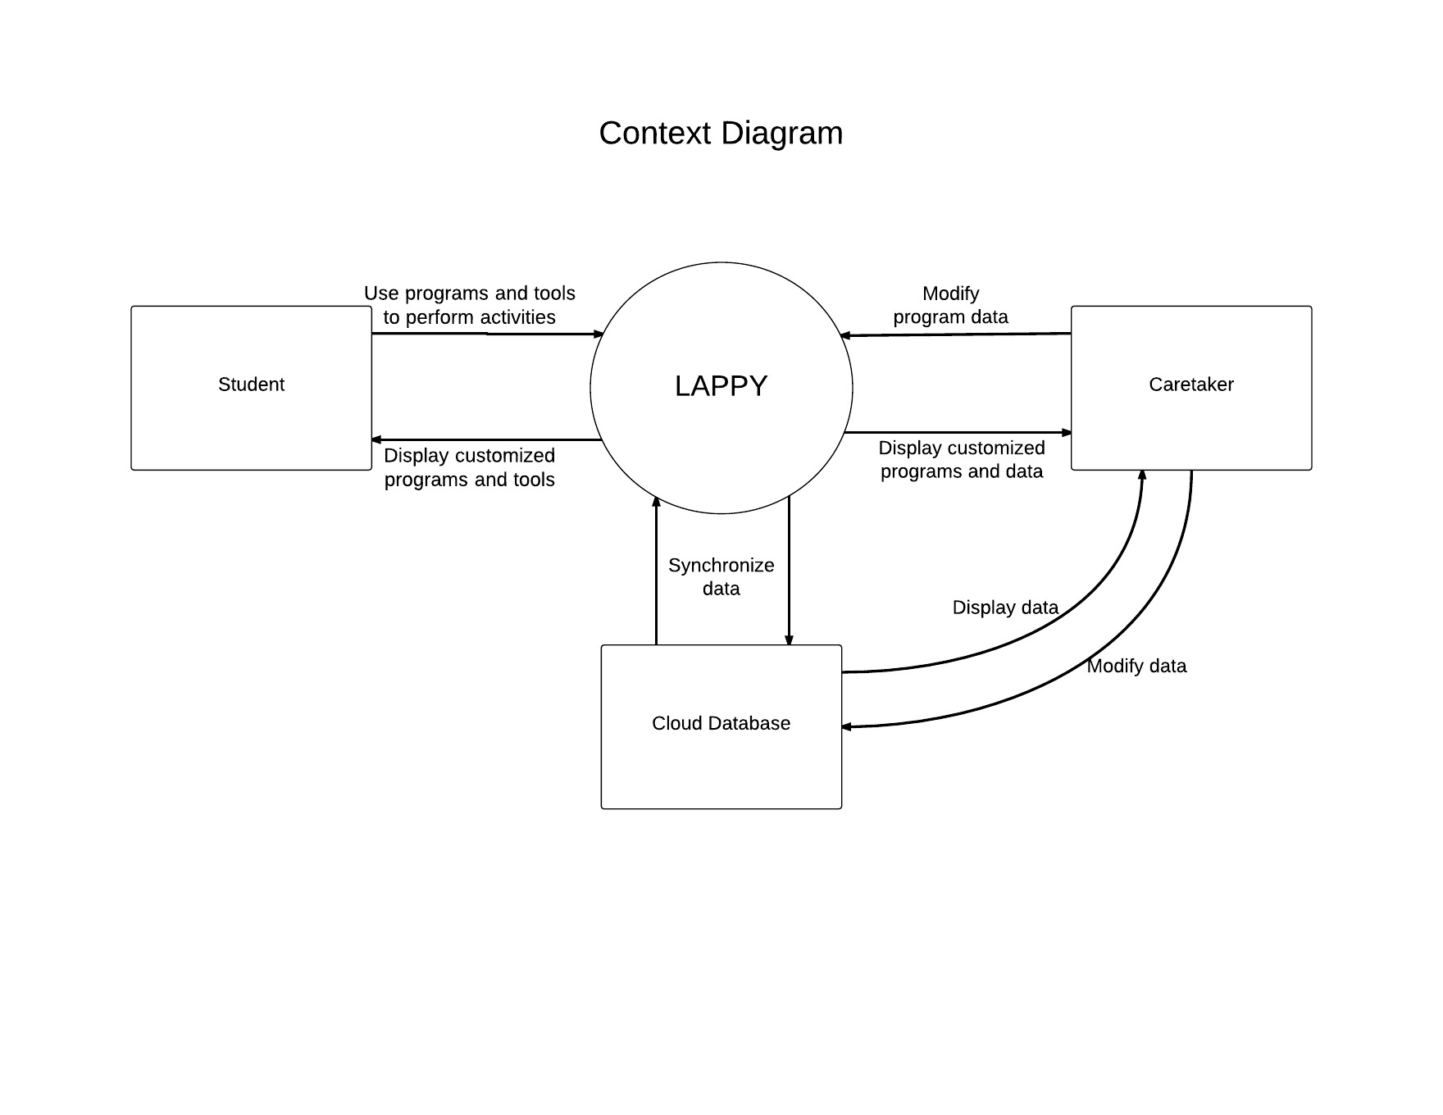
Modeling the Requirements
Context Diagram: Big picture
Definitions:
Student: Child with autism spectrum disorder
Caretaker: Teacher / parent / person assisting student

Slide 21
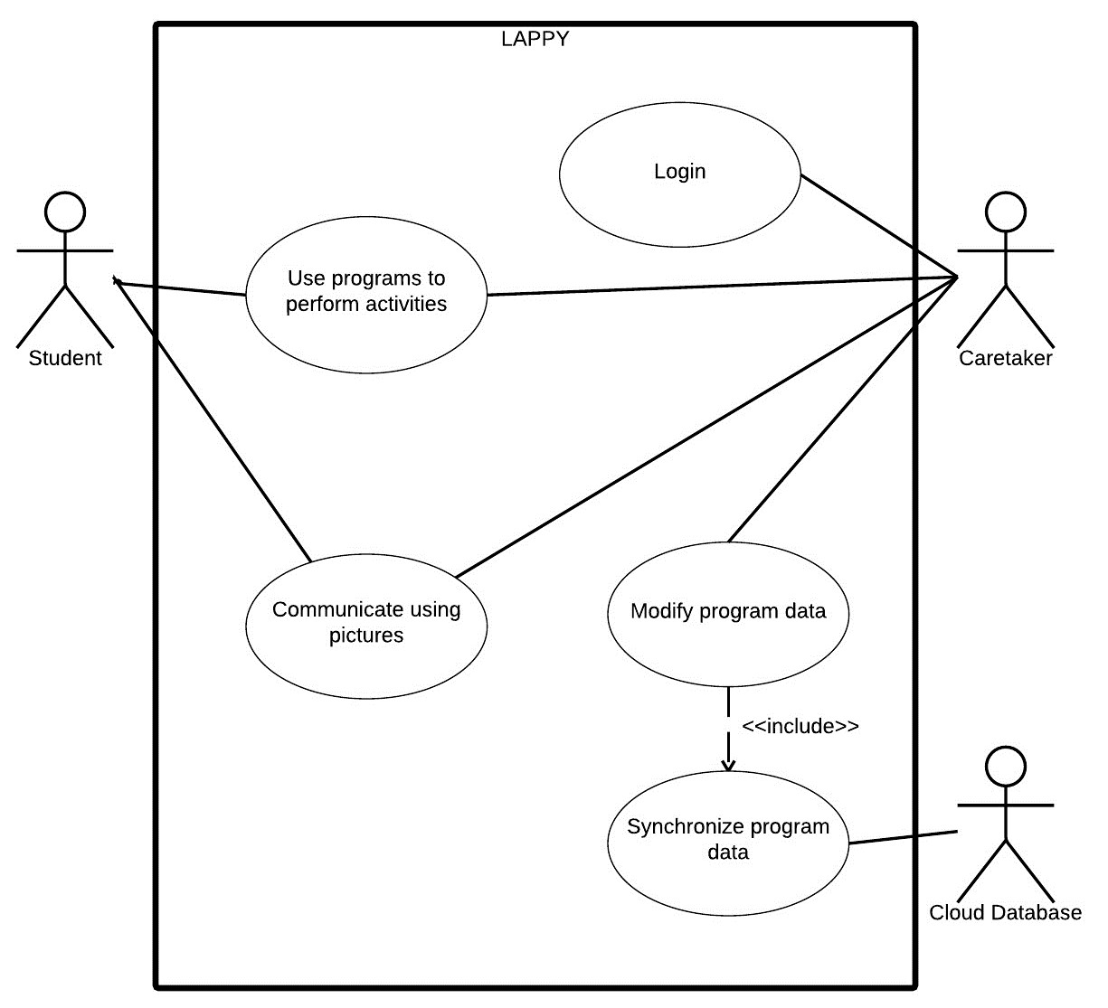
Top-level Use Case Diagram

Slide 22
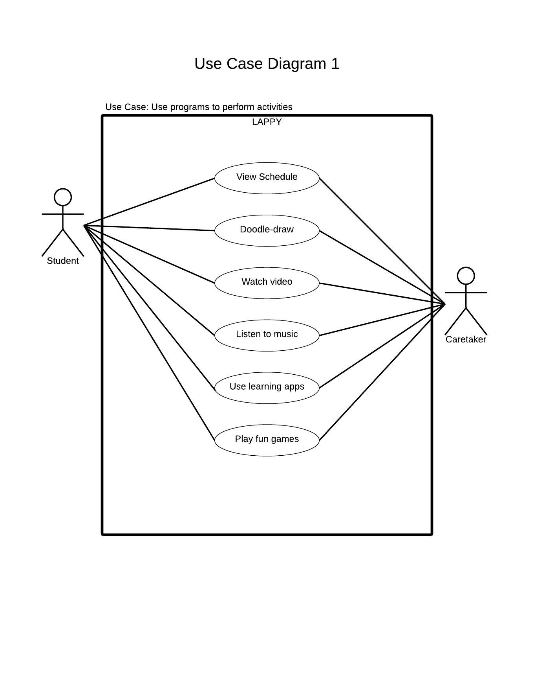
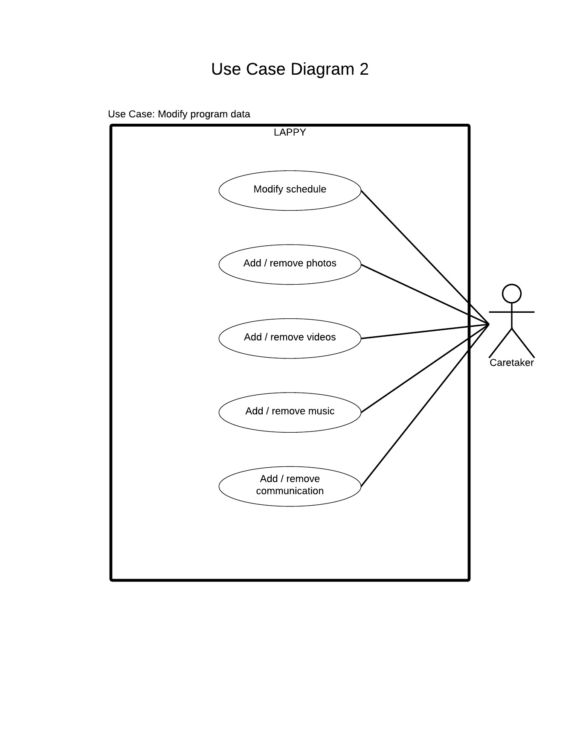
Detailed Use Cases

Slide 23
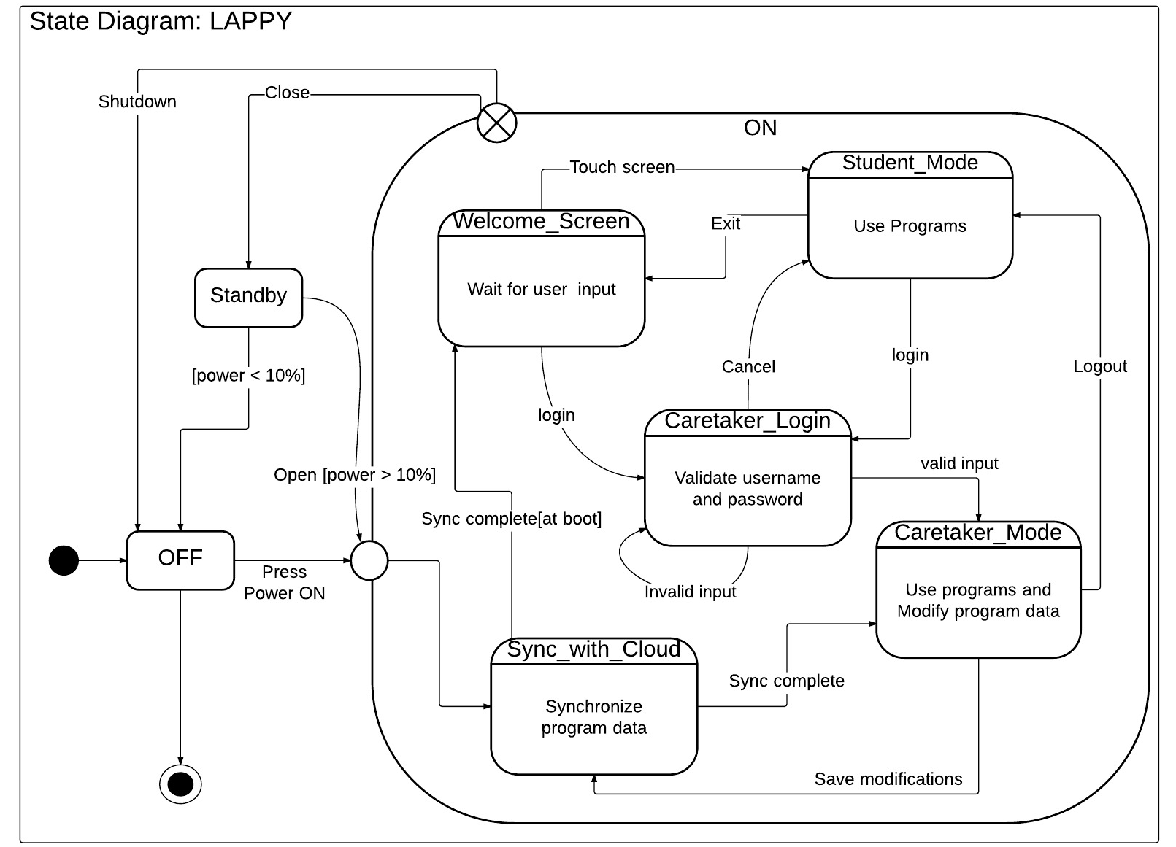
State Diagram

Slide 24
Design
Section 2

Slide 25
Design Phase
Details of product design.
Overview of tasks and activities.
Information of interfaces and components

Slide 26
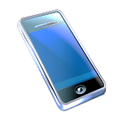



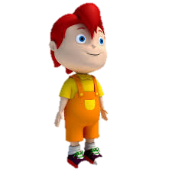
Designing the Requirements
Operational View
Cell Phone
Wi-fi/ Internet
Care Taker
Cloud
Student

Slide 27
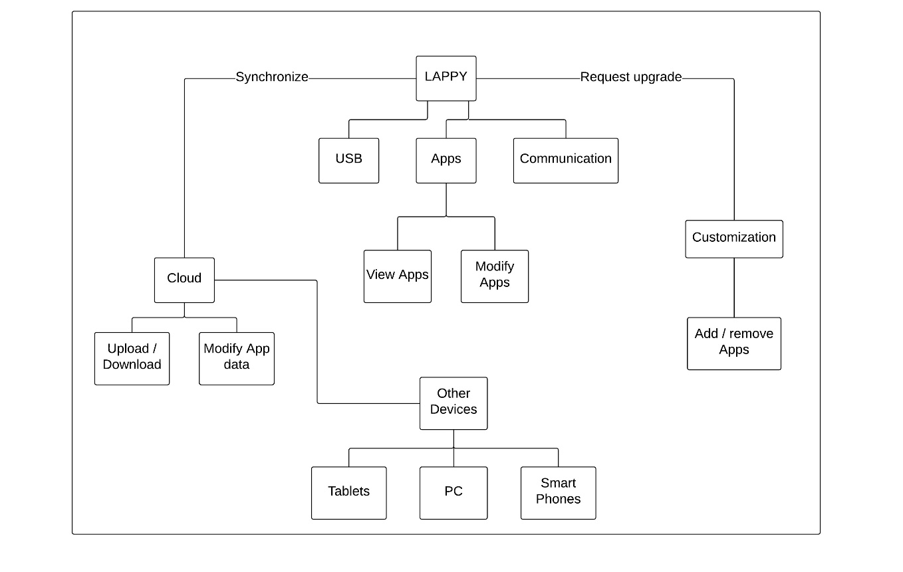
Designing the Requirements
System View I

Slide 28
User Interface
Section 3

Slide 29
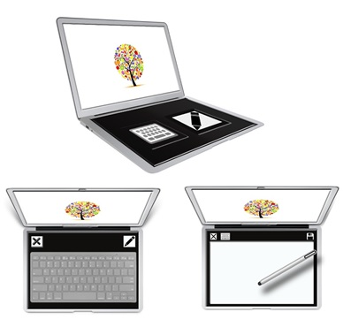
Product Specification
System Name | Lappy
Audio | Available
Bluetooth | Available
Display | 10” LED
Resolution | 1280 by 800 pixels
Headphone jack | Available
HDMI | Not Available
Input | Touch screen
Memory | 2GB/4GB
Memory Card Slot | Available
Microphone | Not Available
Operating System | Google Chrome
Optical Drive | DVD
Power | Rechargeable Lithium ion battery
Processor | Intel core i5
Storage | 8GB SD
Stylus | Available length 5” or 12.5 cm
USB | Available
Webcam | Not Available
Wireless connectivity | Available

Slide 30


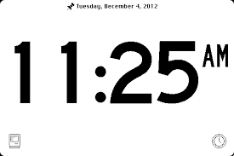

Welcome Screen
Welcome ABC
Caretaker

Slide 31

Caretaker Login Screen
Username
Password
Caretaker
Forgot Password
Cancel

Slide 32










App Screen – Level 1
09:30 AM
MATHS

Slide 33



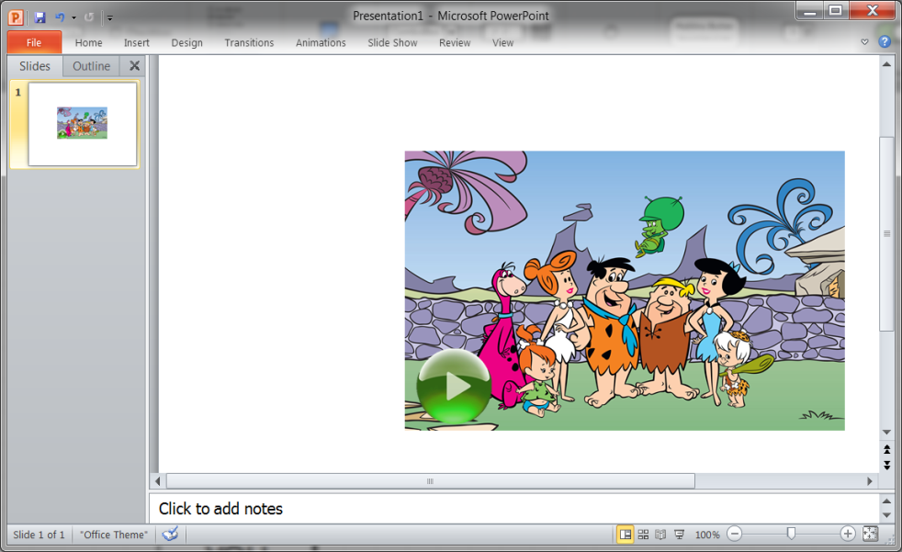
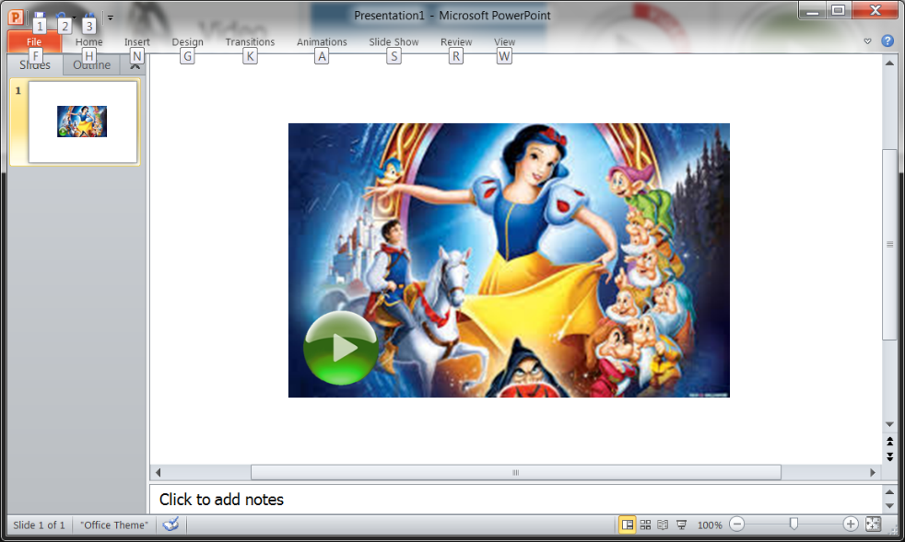

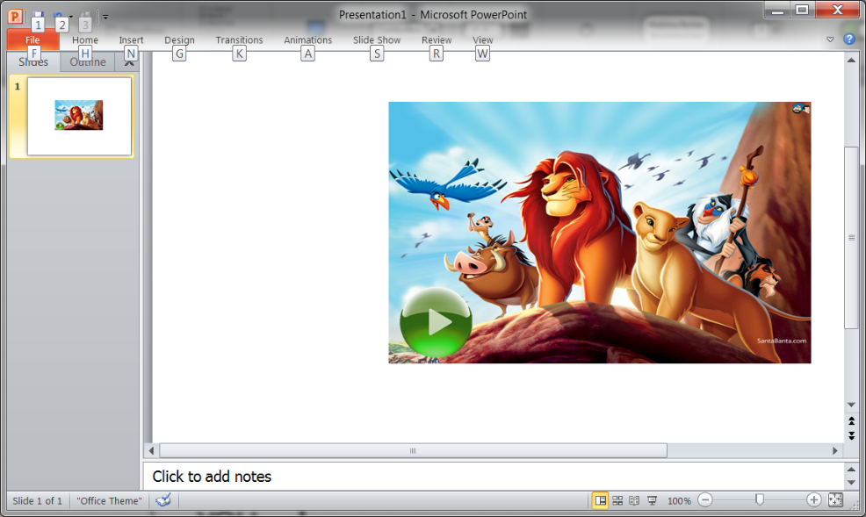
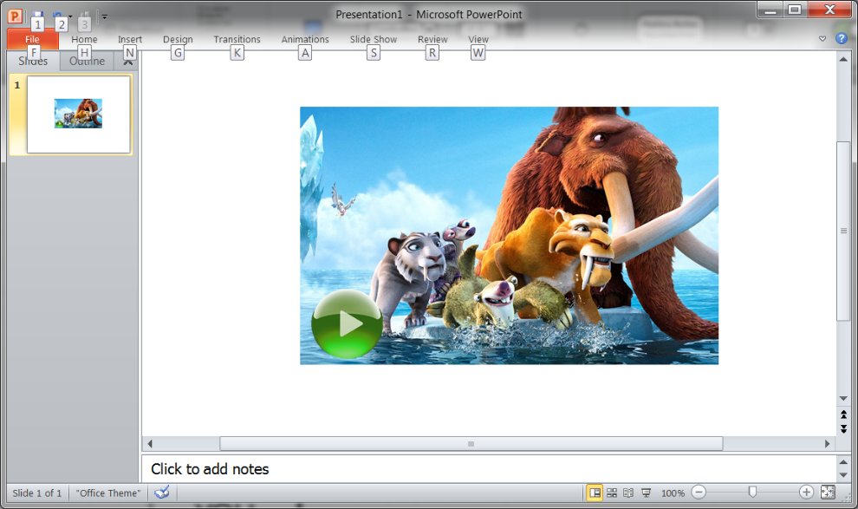
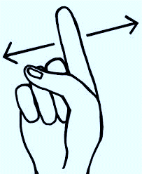


Level 1 - Details

Slide 34








App Screen – Level 2
11.30 AM
PUZZLES

Slide 35











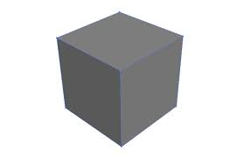
Level 2 - Details
Shape is round
This shape is round

Slide 36

















Scheduler
Today: November 15, 2014
Schedule
Teacher 1
Me
Now
Shapes
Teacher 2
Me
11:30 AM
Puzzles
Teacher 3
Me
11:45 AM
Nations

Slide 37


Scheduler Details
Today: October 31, 2014
Schedule
Teacher 1
Me
Today is
Halloween !
Now
Shapes
Teacher 2
Me
11:30 AM
Puzzles
Teacher 3
Me
11:45 AM
Jack-o-lantern
Halloween
Photos
Halloween
Videos

Slide 38
Conclusion
Easy to use
Simple and attractive UI
Customized to user needs
Aids in learning and interaction
Helps reduce anxiety
Helps reduce communication dependency

Slide 39

Conclusion
Autism is part of who I am
— Temple Grandin
A laptop that makes you happy – it’s a “Lappy”!
The “Lappy” is our attempt at bringing happiness to an autistic child

Slide 40
References
http://www.ncbi.nlm.nih.gov/pubmedhealth/PMH0002494/
http://www.autism-society.org/about-autism/
http://www.autismspeaks.org/what-autism/facts-about-autism
http://en.wikipedia.org/wiki/Autism
http://www.nytimes.com/2014/10/19/fashion/how-apples-siri-became-one-autistic-boys-bff.html?_r=0
http://www.templegrandin.com/
http://www.brainyquote.com/quotes/keywords/autism.html

Slide 41
Thank you!

